Slide 1
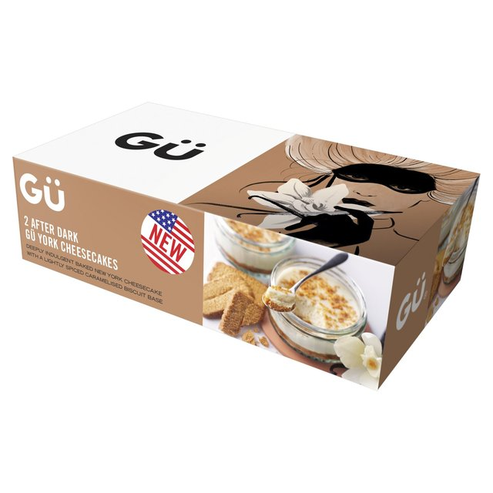
Gu Cheesecake
It’s to good for mum.

Slide 2
What is Gu?
Gu is a international gourmet pudding specialists.
They sell in multiple retailors.
They have never had a single TV advertisement in the past.

Slide 3
Rebranding
Survey indicates perceived consumer to be female.
Both male and female participants all enjoy cheesecake.
Never been targeted at younger consumers.

Slide 4
Ideas for Remarketing
Targeting 16-21 demographic.
Make it theirs.
Make it for anytime.

Slide 5
Storyboard

Slide 6
Final Thoughts
It’s fresh and new!
Treat 16-21 demographic with maturity and not comedy.
No previous marketing constraints.

